Slide 1

Web Application
For ELECTRONICS DATA ANALYSIS

Slide 2




Team Profile
Jithu Sarala Nair
Project Manager
Collaborate with team and ensure timely deliverables.
Anamika Mani Moonjely
Developer
Front-end and Back-end development of Web Application
Buwaneshwari Srinivasan
Data Analyst
Acquire data, build data models and database
Abhirami Suma
Business Analyst
Documentation and proposal preparation.

Slide 3
Data Acquisition
Remote Data Acquisition Process
Data Source: Electronics data source was acquired as XYZ is the largest company focusing on Electronic equipment sales and shipment.
Methodology: Web scraping is the method used to extract data from the data source.
Automation: A pseudo-batch process runs every 24 hours to automatically fetch, process, and store new electronics data, ensuring the dataset remains up-to-date.

Slide 4
Database Design
Database Choice- Amazon Web Service
Type: SQL
Justification: AWS is much efficient and feasible compared to other databases for cloud storage
Storage Process:
EC2 instance was deployed within that instance we installed MySQL server
where the data was fetched from the data source and stored in the cloud database

Slide 5
Web Application Overview
Framework Used: Django for server-side code
Front-End: JavaScript , HTML and CSS using google charts and vs code.
Core Features:
Display of each data analysis done on electronics data.
Interactive dashboard with entries to add an electronic product and its details.
URL Access: The web application can be accessed by clicking the following link:
http://3.145.78.137:8000

Slide 6
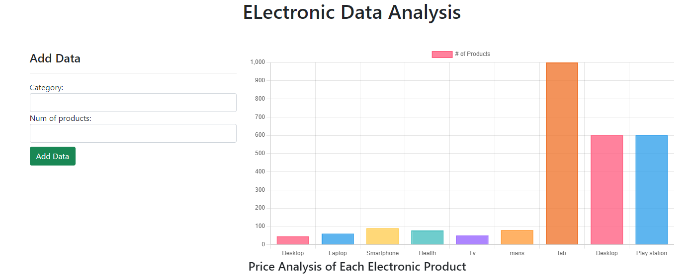
Application Demonstration

Slide 7
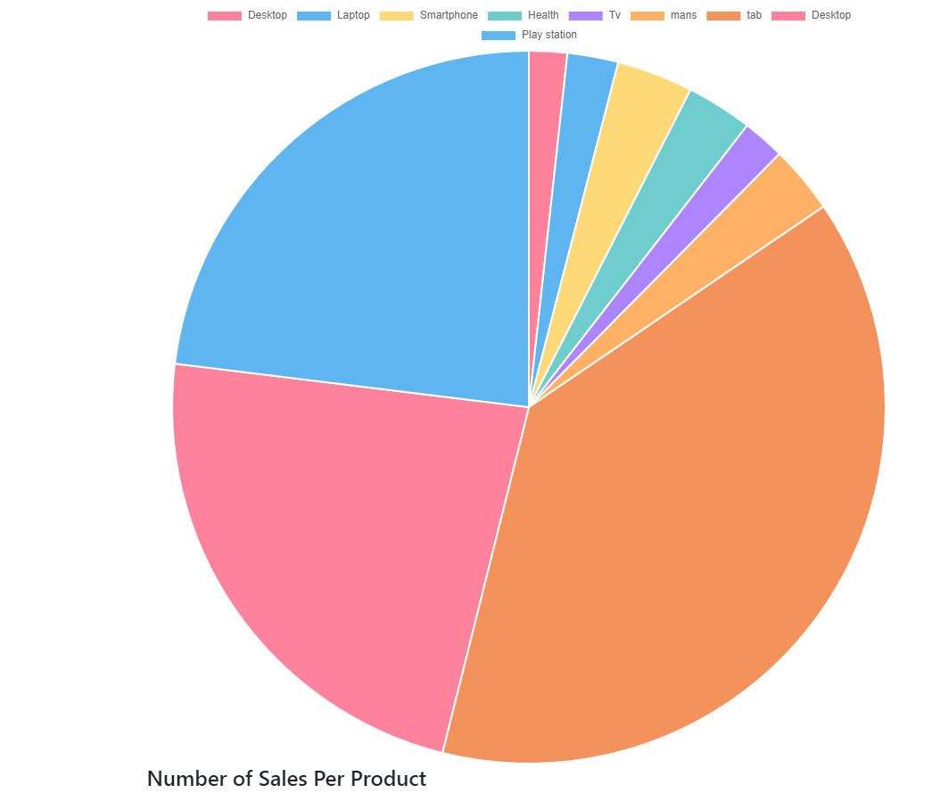

Slide 8
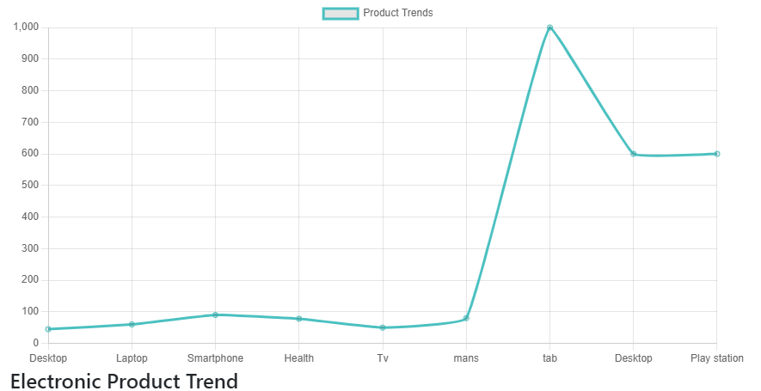

Slide 9
Fit-Gap Analysis
Fit-Gap Summary
Fit: Web application was deployed
Fit: Interactive dashboard with application to add product and its details
Fit: Live URL access with data stored in cloud database
Fit: API to fetch live weather details of a particular location
Gap: Larger and multiple data source can be fetched as future deployment
Gap: More structured and detailed data analysis and research visualization can be done

Slide 10
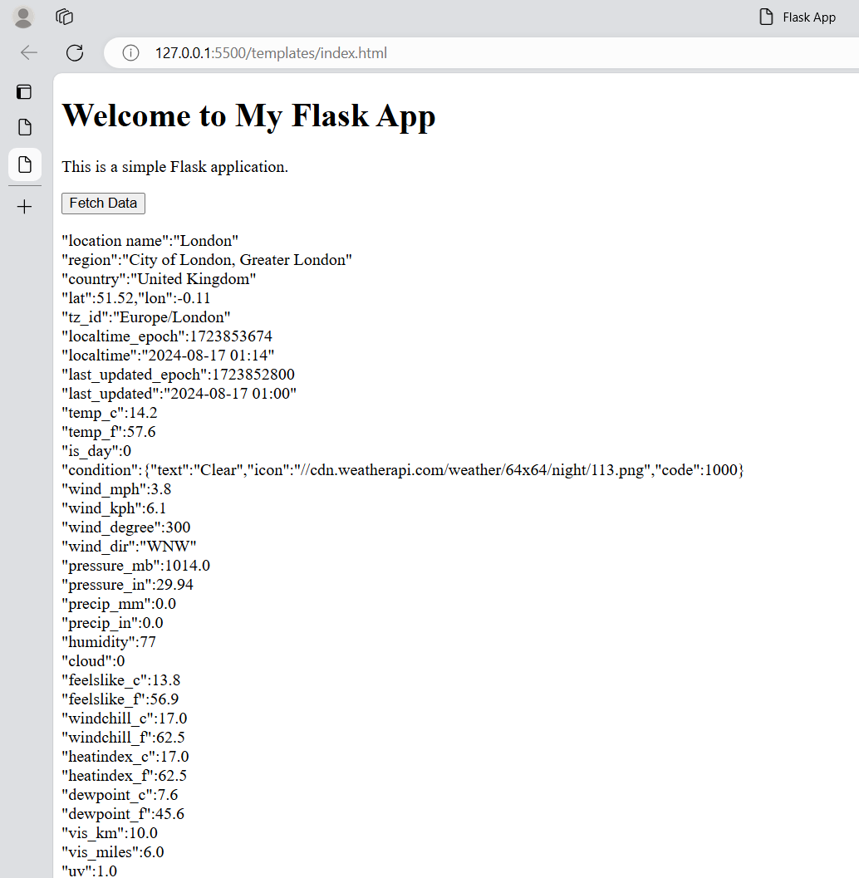
API Development
Overview of API
Functions: Get the live weather details of each specified location
.
Demonstration:

Slide 11
Conclusion
Final Summary
Successfully deployed a web application with a live URL, utilizing AWS for cloud storage and Django for server-side operations, showcasing strong technical execution.
Implemented a solid data acquisition process via web scraping and automated it with a 24-hour pseudo-batch process, ensuring the dataset remains up-to-date.
Developed an interactive dashboard with capabilities for adding new electronic products, providing a user-friendly interface for data analysis and visualization.
Efficiently integrated AWS, SQL, and front-end technologies like JavaScript, HTML, and CSS, demonstrating the team's proficiency in modern web development practices.
The team is well-prepared for scaling the project, with plans to expand data sources and enhance data analysis capabilities, indicating strong potential for future projects.

Slide 12

Thank You

